Slide 1
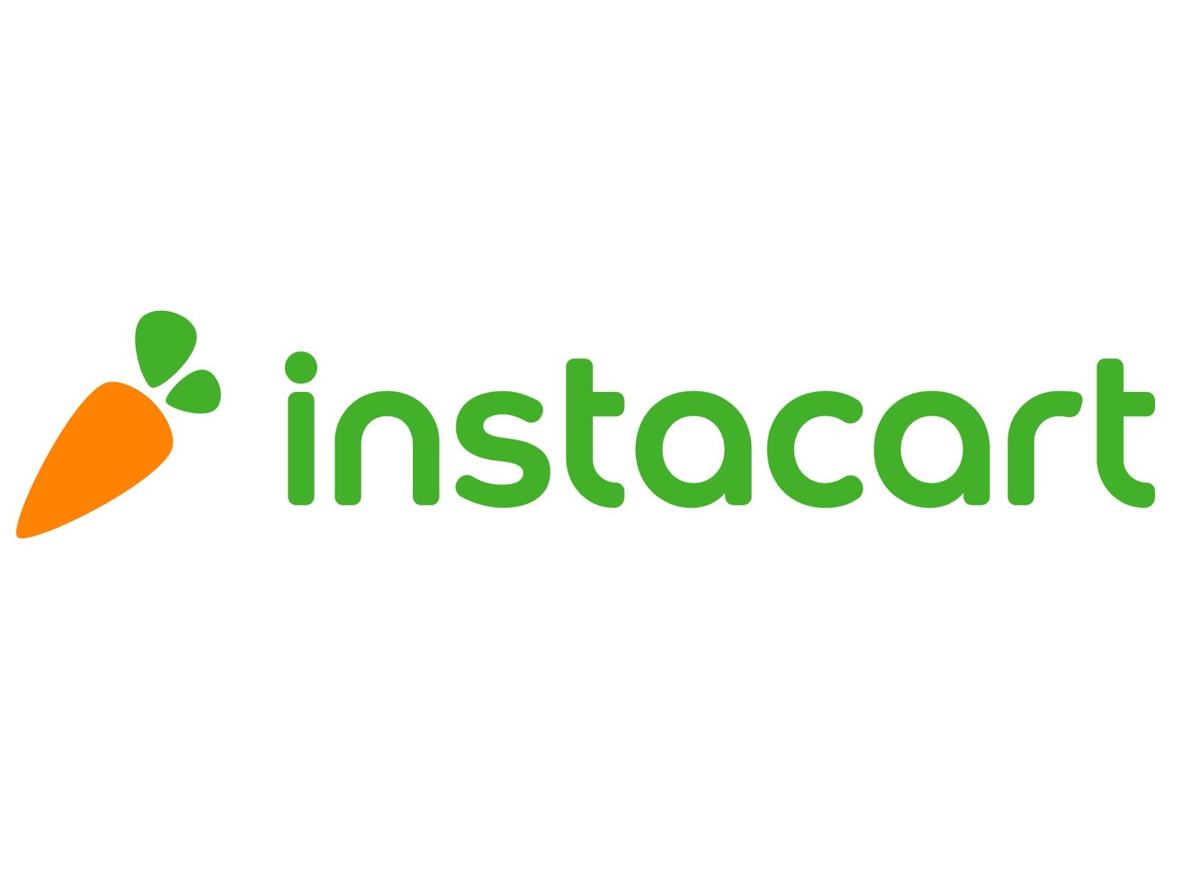


DATA 603 – Platforms for Big Data Processing
Market Basket Analysis
Harish Krishnamoorthy
Purushotham Jagadeesh
Saiketan Gande
Pooja Anil
This Photo by Unknown Author is licensed under CC BY-NC-ND

Slide 2
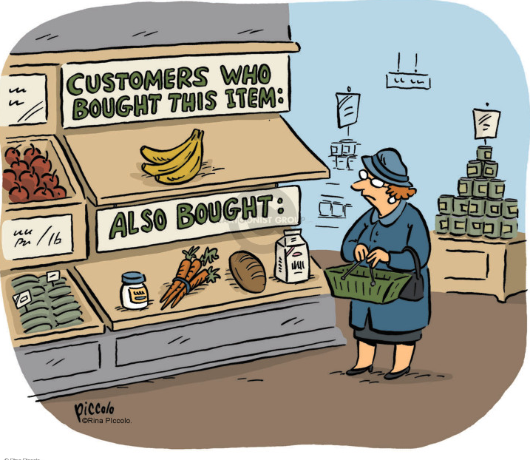

Slide 3
Product Placement
“Identifying products that may often be purchased together and arranging the placement of those items (such as in a catalog or on a web site) close by to encourage the purchaser to buy both items.”
Reference: https://aofund.org/resource/product-placement-why-it-matters-and-how-get-it/

Slide 4
Problem Analysis
Using a three million Instacart dataset and order histories to build a recommendation system that aids better customer engagement, customer satisfaction, and business efficiency. All of this by recommending the right item based on analysis of association between the products and buying pattern.
Relevance
Objective
Strategy
User Satisfaction and engagement.
Business Efficiency and Growth
Right products in the right place and time.
Understanding different customer buying pattern.
Understanding the profit areas and maximizing the same.
Recommending right products on right time.
Collecting, cleaning and grouping data to aid effective analysis and visualization.
Using logistic regression machine learning model called FP growth algorithm of association rule mining.

Slide 5


The Data
Real Instacart Dataset from Kaggle
https://www.kaggle.com/competitions/instacart-market-basket-analysis/data?select=orders.csv.zip
https://www.instacart.com/datasets/grocery-shopping-2017
orders(~3.4 M)
products(~50 K)
aisles(134)
departments(21)
order_products_SET(~3 M +)

Slide 6
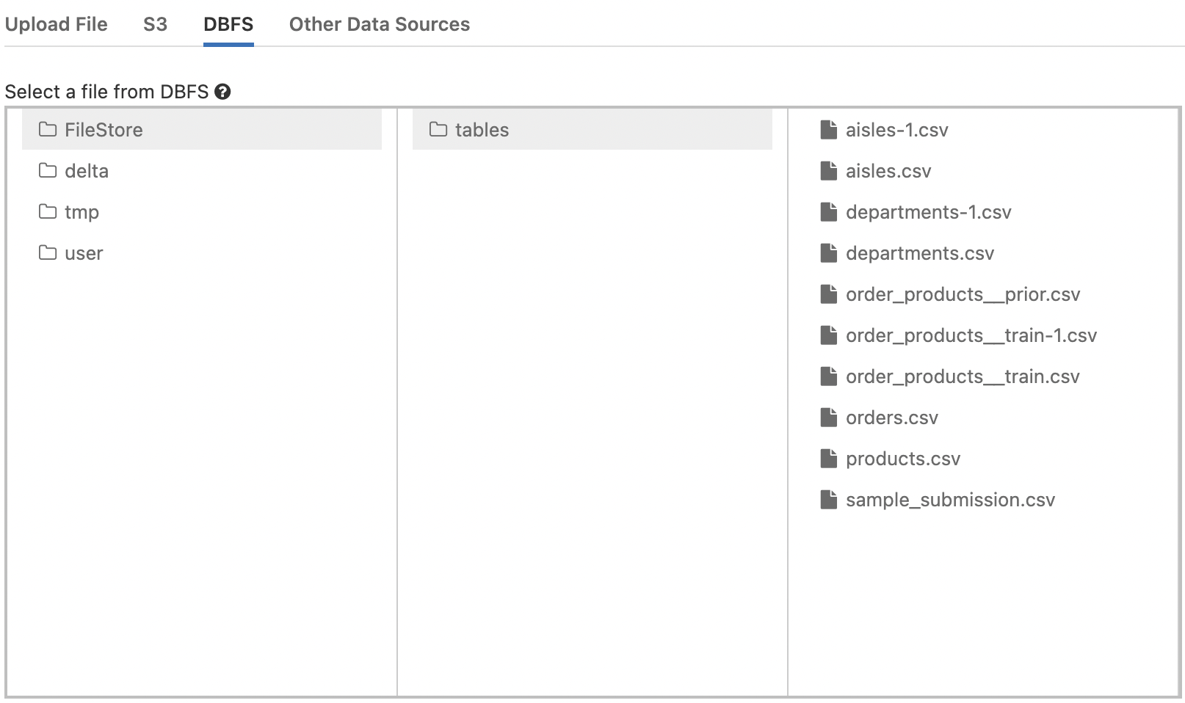
Data Storage
All the data tables are stored in a DBFS file of Databricks.

Slide 7
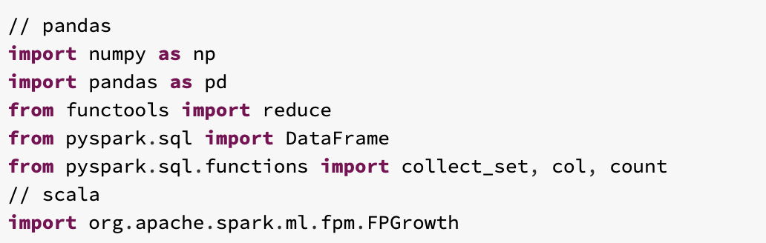
Shared workspace notebook environment in Databricks
https://databricks-prod-cloudfront.cloud.databricks.com/public/4027ec902e239c93eaaa8714f173bcfc/2369395306214346/4499639871704699/3174366705860897/latest.html
Libraries Imported

Slide 8

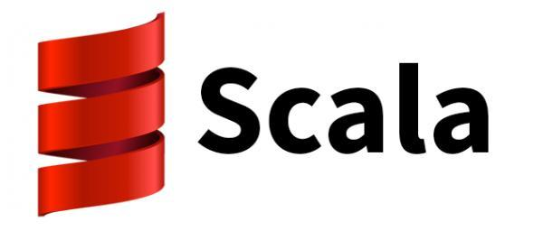


Platform
Languages Used

Slide 9

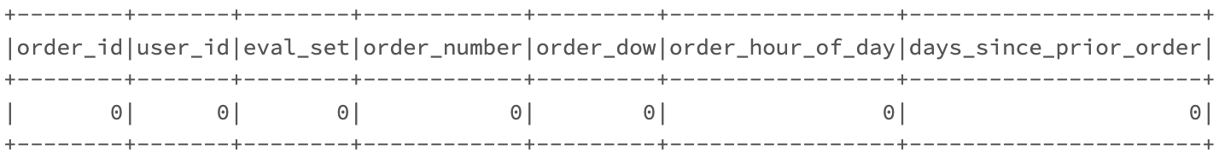
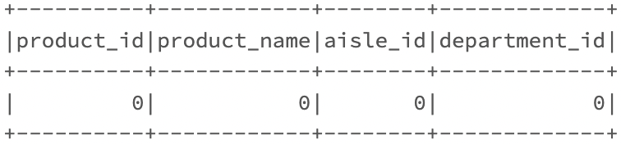
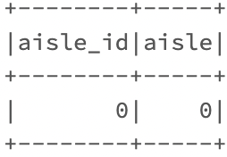
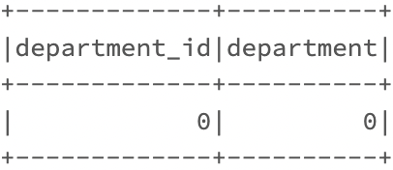
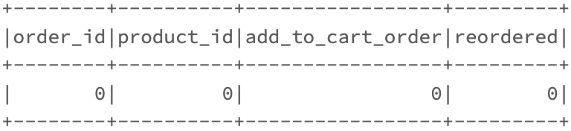
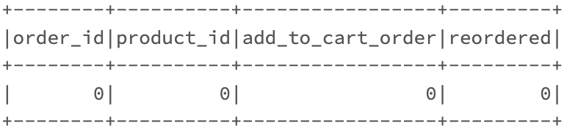
Data Pre-Processing
1. Null Value Check

Slide 10
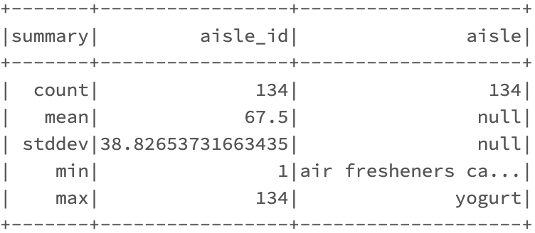
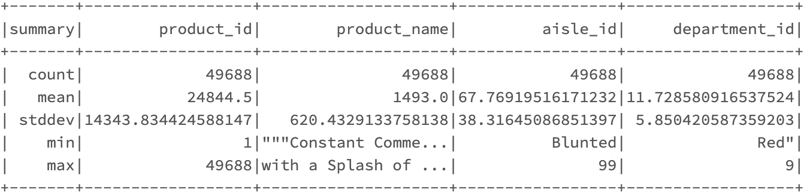
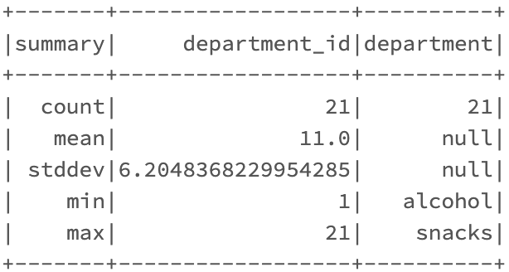
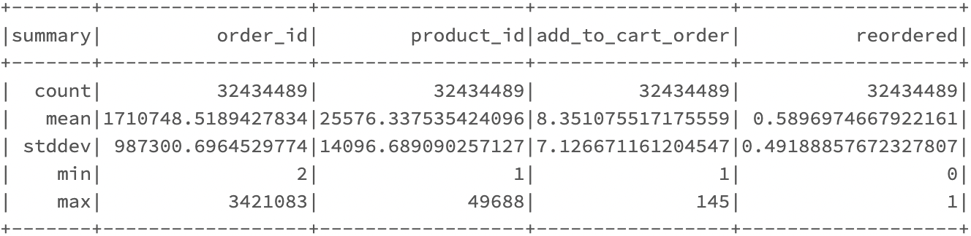
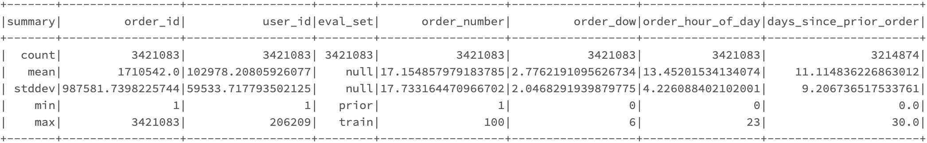
Data Pre-Processing
2. Statistical Summary Using Describe (Sanity Check)

Slide 11
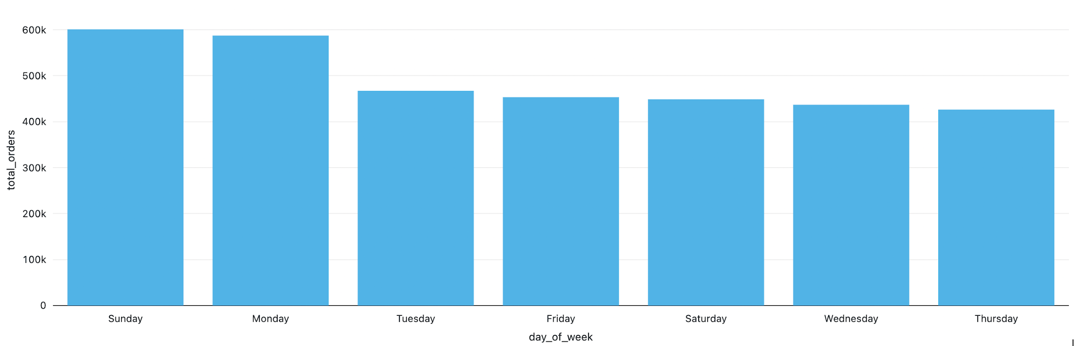
EDA and Databricks Visualization
Orders by the Day of the Week
Result : Most of the Instacart orders are placed on Sundays and Mondays. This indicated that people mostly prefer stocking up for the work week or start ordering groceries after the weekend fun!

Slide 12
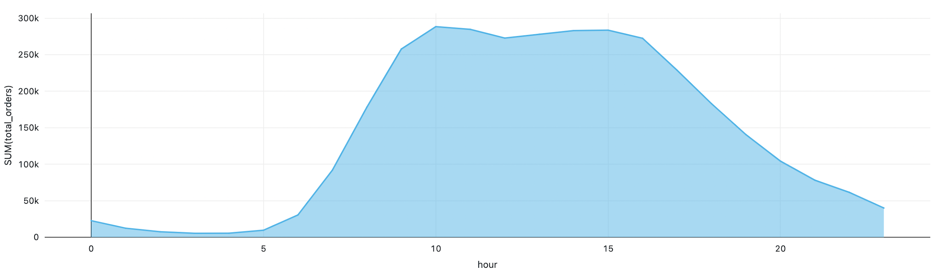
EDA and Databricks Visualization
Orders across Hours of the Day
Result :Surprisingly, majority of the orders are made between 10 AM to 4 PM. This indicated an involvement in grocery shopping balanced with work life.

Slide 13
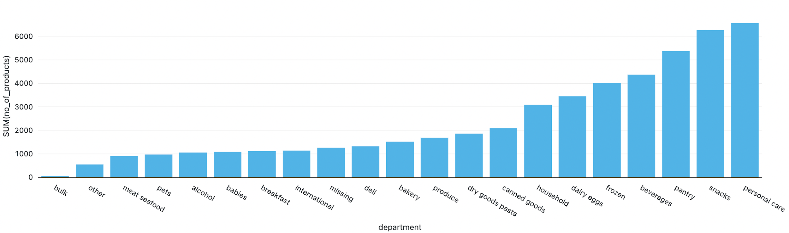
EDA and Databricks Visualization
Departments with most products
Result : Personal Care and Snacks are the departments that have the highest number of products in them.

Slide 14
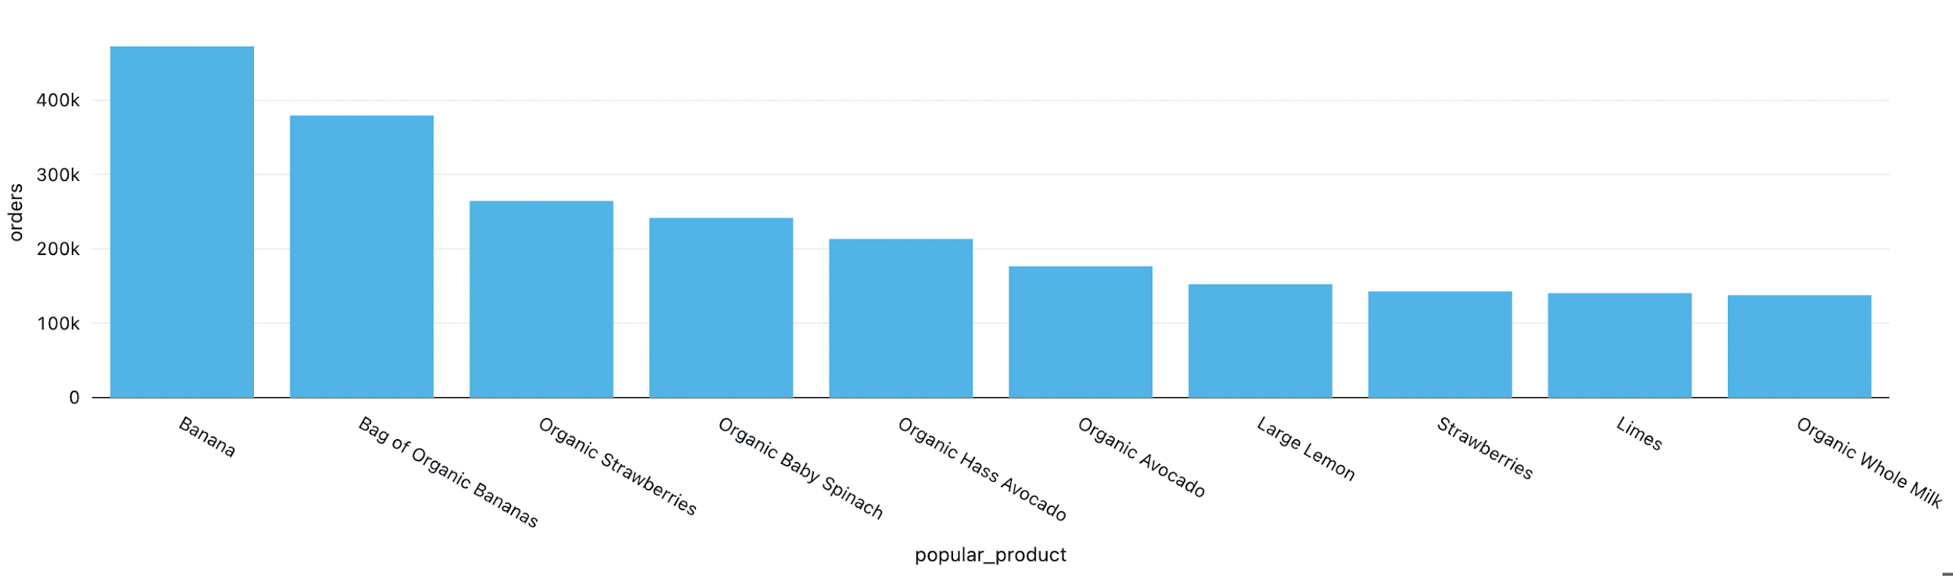
EDA and Databricks Visualization
Most Popular Products
Result :Bananas and Strawberries are the most popular products, followed by greens and veggies! Healthy way the right way!

Slide 15

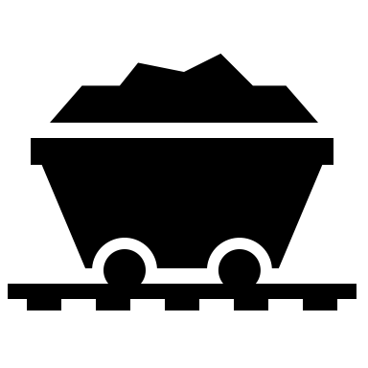


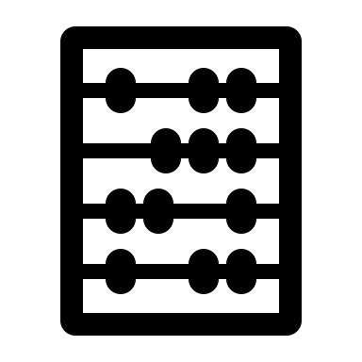

Association Rule Mining
It is a Knowledge Discovered in Data
Is a Data Mining Technique
Mines Frequency Pattern using association rule Generation
Association rule is an expression/relation between two disjoint itemsets
It uses Metrics to measure the interest of an association rule named as; Lift, Support and Confidence
Higher the metrics, higher the interest of the rule.
Reference: https://www.upgrad.com/blog/association-rule-mining-an-overview-and-its-applications/

Slide 16
Association Rule Mining - Metrics
Support - This measurement reveals how frequently a given itemset appears in all transactions. It seems sense that support calculates the percentage of transactions that contain each given basket, A, as a subset. For example, if an item appears 3 out of 5 transactions, it has a support of 3/5=0.6.
2. Confidence - Given that the cart already possesses the antecedents, this measurement determines the likelihood of the consequence occurring on the cart. In simple sense, Confidence refers to the amount of times a given rule turns out to be true in practice.
3. Lift - The lift value of an association rule is the ratio of the confidence of the rule and the expected confidence of the rule. It is the measure of the performance of a targeting model (association rule) at predicting or classifying cases as having an enhanced response (with respect to the population as a whole), measured against a random choice targeting model.
Reference: https://https://www.geeksforgeeks.org/association-rule/

Slide 17
FP Growth Algorithm
https://www.softwaretestinghelp.com/fp-growth-algorithm-data-mining/
It all started with Apriori Algorithm, which is an algorithm for frequency pattern analysis in the logistic Regression method of machine learning that generates itemsets and discovers most recent itemset.
FP Growth Algorithm is an improvement for Apriori where a frequency pattern is generated without a candidate generation.
The algorithm represents the pattern in the form of a tree, also called as FP Tree or Frequency pattern tree.
This algorithm mines the recent frequency pattern with itemset at the top of the tree and each item of the itemset as the nodes. The association of the nodes with the lower nodes that is the itemsets with the other itemset are maintained while forming the tree.
Reference: https://www.softwaretestinghelp.com/fp-growth-algorithm-data-mining/

Slide 18


FP Growth Algorithm - Steps
Counting the occurrences of individual items
Order the itemsets based on individual occurrences
Step 1
Step 2
Step 3
Step 4
Filter out non-frequent items using minimum support
Create the tree and add the transactions one by one
Reference: https://www.softwaretestinghelp.com/fp-growth-algorithm-data-mining/

Slide 19
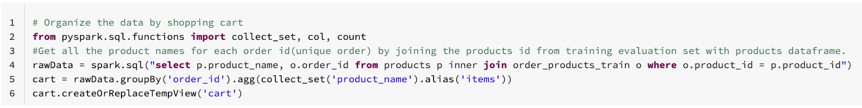
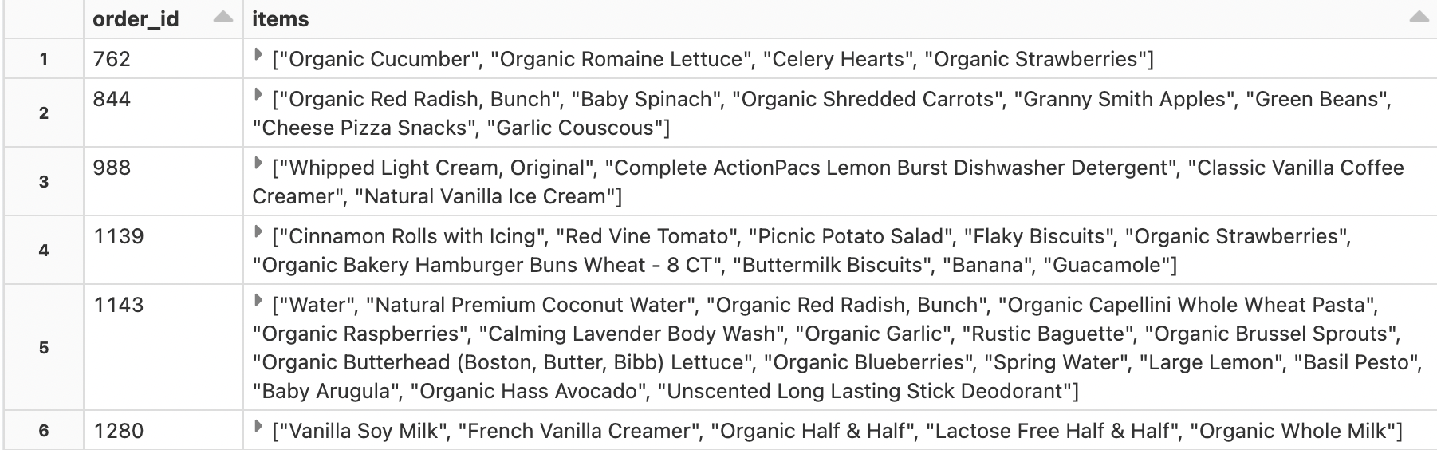
Data Preparation for Association Rule Mining
Making the cart dataset
The cart
Result : The cart table has ~1.3M of rows(carts).

Slide 20
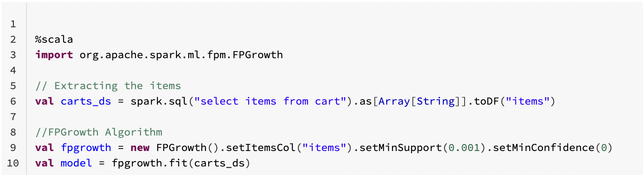
Data Feeding into the FP Growth Algorithm
Removal of Non-Frequent itemsets using support.
The support assumption for out project is 0.001, which also means that Which also means that one in every 1000 basket has this cart!
Support = Total Number of similar carts/Number of total links.
We limit the support to 0.001 as any itemset might need a minimum support to be identified as frequent.

Slide 21
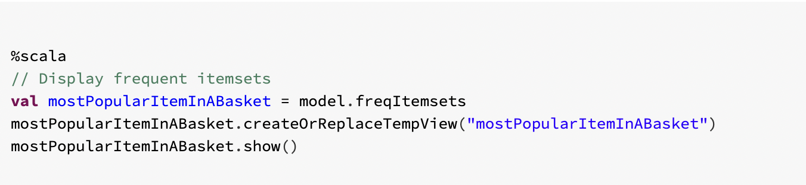
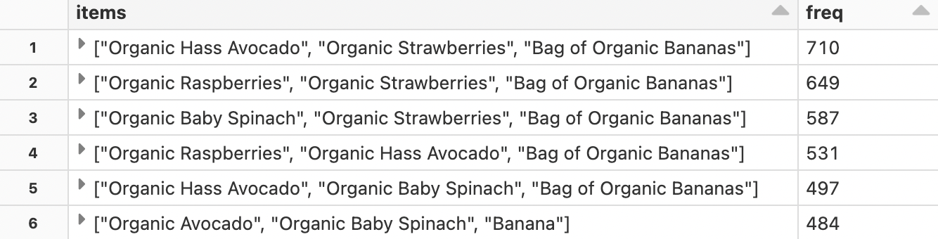
Looking at the most frequent Orders
”freqItemsets” is a method provided by FP Growth Algorithm to frequent itemsets.
Using SQL to limits carts with less than 2 items.
Result
Result : The cart with ["Organic Hass Avocado", "Organic Strawberries", "Bag of Organic Bananas"] has the highest frequency of 710.

Slide 22
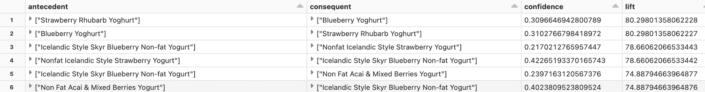
If/Then, Confidence, Lift and more..
Association rule mining rules out the consequent(then) for every antecedent(if) using its frequency pattern tree. Hence, the below snipper called the association rule method.
The queried data is as follow,
Interpretation: If somebody Purchases a [Strawberry Rhubarb Yogurt] then It is likely that they will want to buy [Blueberry Yogurt] based on the confidence and lift.

Slide 23
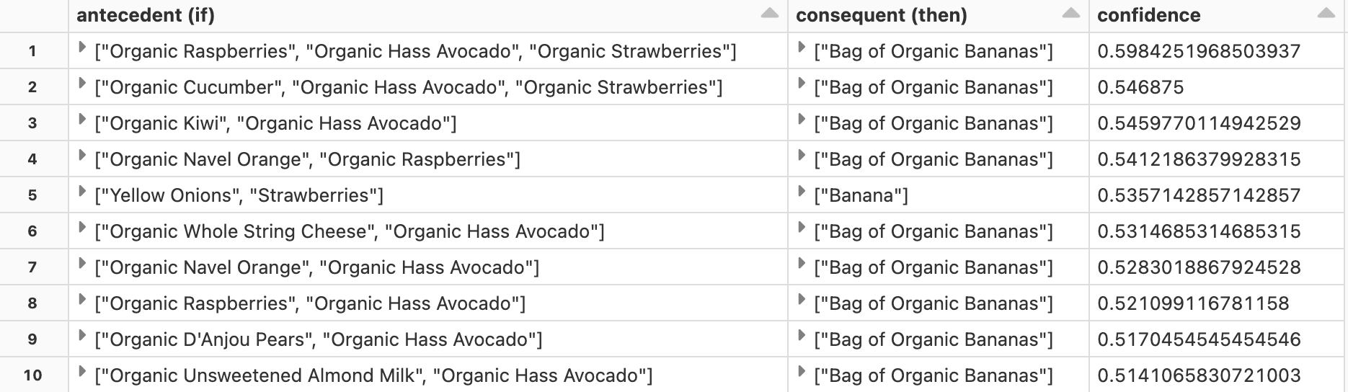
Final Recommendation System
Result: The above table depicts the basket as antecedent or ifs and then analyses them to provide consequent (Then) recommendations sorted by the confidence.

Slide 24








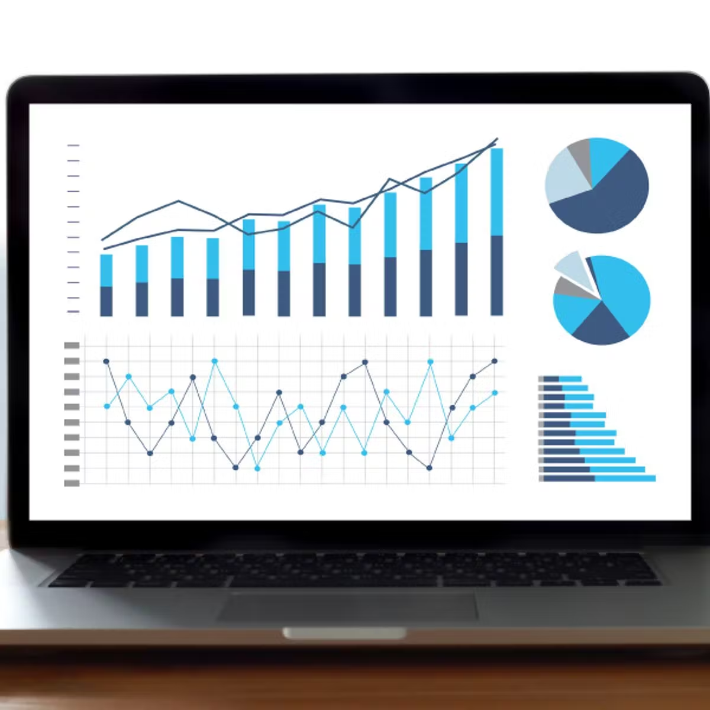


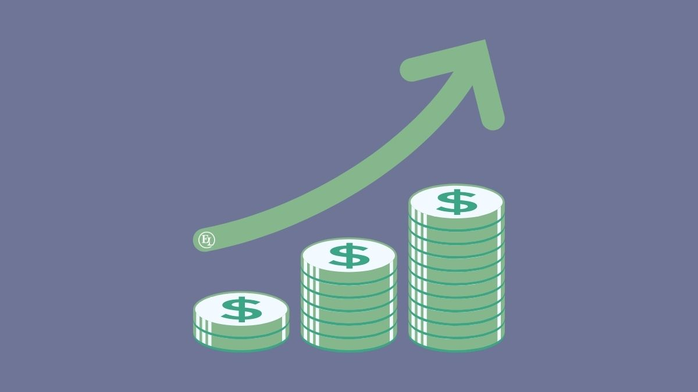
Big Data Pipeline
Collect
Ingest
Store
Compute
Use

Slide 25

Thank you!
Questions

